Slide 1

Reading and Phonics in Reception
2025 – 2026

Slide 2
What learning looks like in Reception
Prime areas of learning
Communication and Language |  | Physical Development |  | Personal, Social and Emotional Development
Specific areas of learning
Literacy | Mathematics |  | Understanding the World |  | Expressive arts and design
Reading
Writing

Slide 3
Reading in Reception
It is crucial for children to develop a life-long love of reading.
Reading consists of two dimensions: language comprehension and word reading.
Language comprehension (necessary for both reading and writing) starts from birth. This develops when adults talk to children about the world around them and the books (stories and non-fiction) they read with them, and enjoy rhymes, poems and songs together.
Skilled word reading involves both the working out of the pronunciation of unfamiliar printed words (decoding) and the recognition of familiar printed words. Children’s fluency in these skills will build over time to become independent readers.

Slide 4
Reading Early Learning Goals
ELG: Comprehension
“Children at the expected level of development will: - Demonstrate understanding of what has been read to them by retelling stories and narratives using their own words and recently introduced vocabulary; - Anticipate – where appropriate – key events in stories; - Use and understand recently introduced vocabulary during discussions about stories, non-fiction, rhymes and poems and during role-play”.
ELG: Word Reading
“Children at the expected level of development will: - Say a sound for each letter in the alphabet and at least 10 digraphs; - Read words consistent with their phonic knowledge by sound-blending; - Read aloud simple sentences and books that are consistent with their phonic knowledge, including some common exception words”.

Slide 5
How can we help children on their reading journey?
Reading a variety of genres of stories and texts to them.
Telling them made up stories and traditional tales.
Book handling skills; being respectful with how we treat books.
Model reading to your child.
Using pictures to tell a story.

Slide 6
What is Phonics?
- Phonics is a method of teaching children at the start of their reading journey to read and pronounce words by learning the usual sound of letters, letter groups, and syllables.
- In schools, Phonics is broken down into ‘Phases’.
- Phase 1-4 are initially covered and taught when children are in Reception.
- Some of these phases are covered again in Year 1 and 2, along with the final Phase, Phase 5.

Slide 7
What is Phonics?
Children are taught to read (and eventually spell) by linking the sounds they hear with the way the sounds are written.
Term | Definition
Phoneme | The spoken sound you hear.
Grapheme | The way a phoneme is written.
Digraph | Two letters that make one phoneme (e.g. ch)
Trigraph | Three letters that make one phoneme (e.g. igh)
Split digraph | Two letters making one phoneme that is split by another grapheme (e.g. Bone)
Segment | Splitting a word up into phonemes (e.g. c-a-t)
Blend | Putting a word back together after segmenting (cat)
Decode | The process of segmenting and blending.
Tricky words/Common Exception Words | Words that can't be decoded phonetically.

Slide 8
Phonics at Christ Church Primary School

Slide 9
Phonics at Christ Church
High quality teaching of Phonics is a top priority at Christ Church.
Children in Reception, Year 1 and Year 2 are taught phonics daily from 9am – 9.30am.
Since joining us in September, your child will have completed an informal phonics assessment with one of their class teachers. This is so that the teachers have been able to quickly develop an understanding of each child’s phonic knowledge.
The teachers have readily used this information to guide their Phonic teaching. Your child will be taught phonics in Phases (Phase 1-4 in Reception) over the academic year.

Slide 10
Phonics in our School
At Christ Church we follow the Government approved Systematic Synthetic Phonics programme online called ‘Bug Club’.
Phonic lessons are largely based on repetition to enable children to recall information they have learnt previously in Phonics.
Lessons are fast paced and follow the structure of revisit, teach, practise and apply.
There are a number of areas in the classroom for children to apply their phonics learning both independently and with support throughout the day.

Slide 11
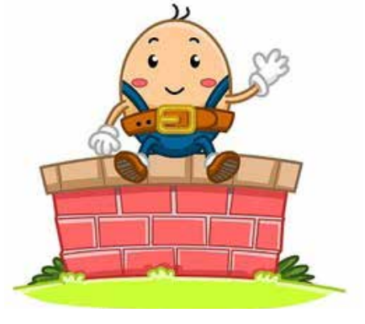


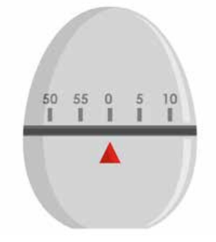

Phonics at Christ Church
Phase 1
- Children are taught about:
Environmental sounds, instrumental sounds, body percussion (e.g. clapping and stamping), rhythm and rhyme, alliteration, voice sounds and oral blending and segmenting (e.g. hearing that d-o-g makes ‘dog’).

Slide 12
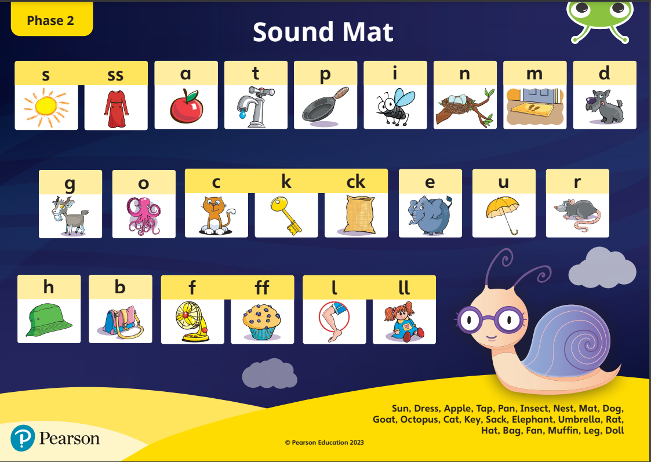
Phonics at Christ Church
Phase 2
- Children begin to learn the sounds that letters make (phonemes).
- There are 44 sounds in all. Some are made with two letters, but in Phase 2, children focus on learning the 19 most common single letter sounds.

Slide 13
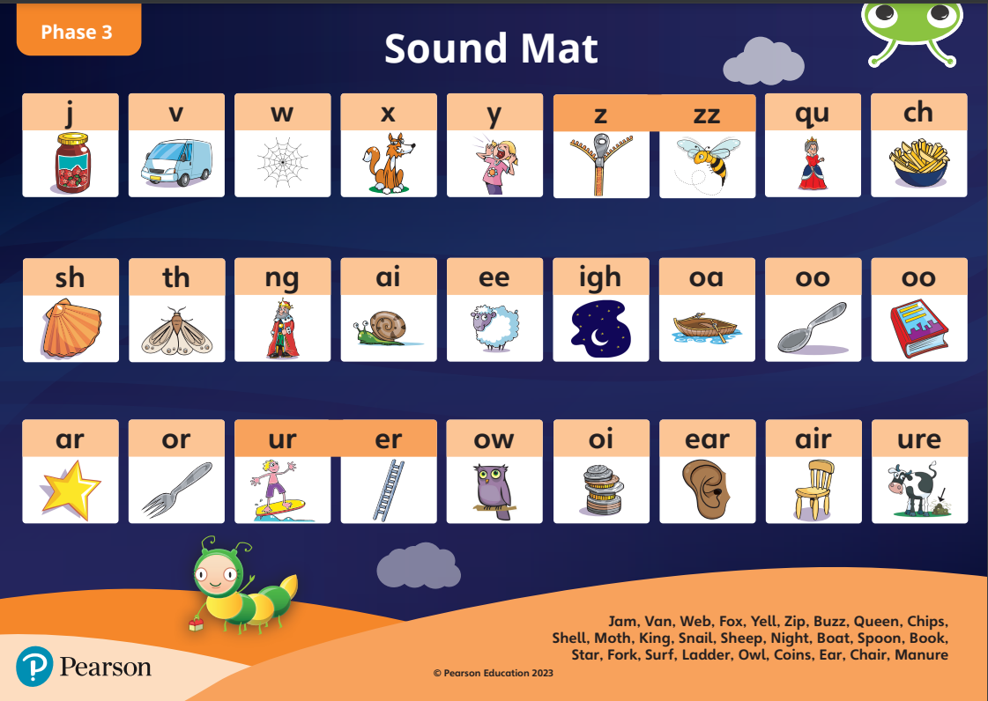
Phonics at Christ Church
Phase 3
- Phase 3 begins by introducing children to the remaining, more difficult and/or less commonly used individual letter phonemes. They are then introduced to the most common digraphs that make up vowel sounds alongside key common sounds
- Alongside this, children are taught to recognise more tricky words, including ‘me,’ ‘was,’ ‘my,’ ‘you’ and ‘they’

Slide 14
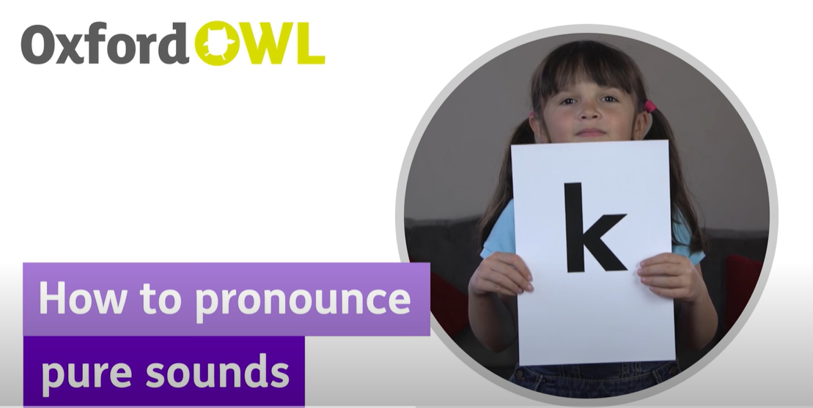
Pronunciation of Phonemes
- Phonemes should be taught using a pure sound.
Phonemes should not have the “uh” added on to the end of the phoneme.
Phonics: How to pronounce pure sounds | Oxford Owl

Slide 15
Phonics at Christ Church
Phase 4
- At this point children should be confident in the phoneme/grapheme correspondences that have already been taught.
- In Phase 4 children will, among other things:
Practise reading and spelling CVCC words (‘bump', 'nest', ‘belt,’ ‘milk’, etc.)
Practise reading and spelling high frequency words
Practise reading and writing sentences
Learn more tricky words, including ‘have,’ ‘like,’ ‘some,’ ‘little’

Slide 16
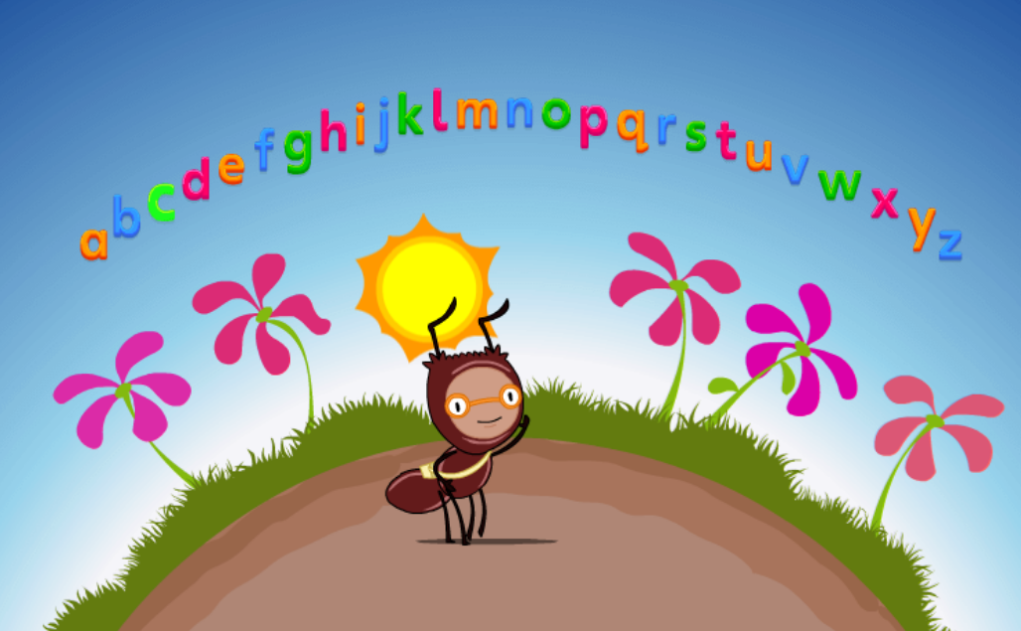

Phonics at Christ Church

Slide 17
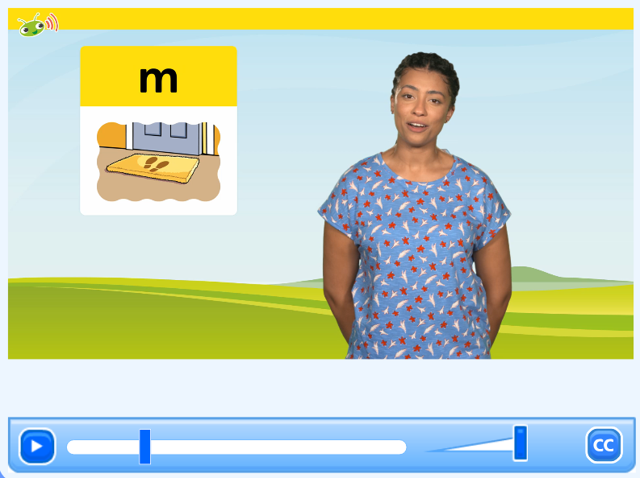
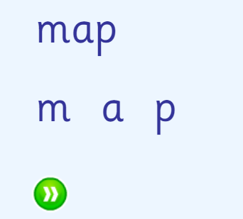
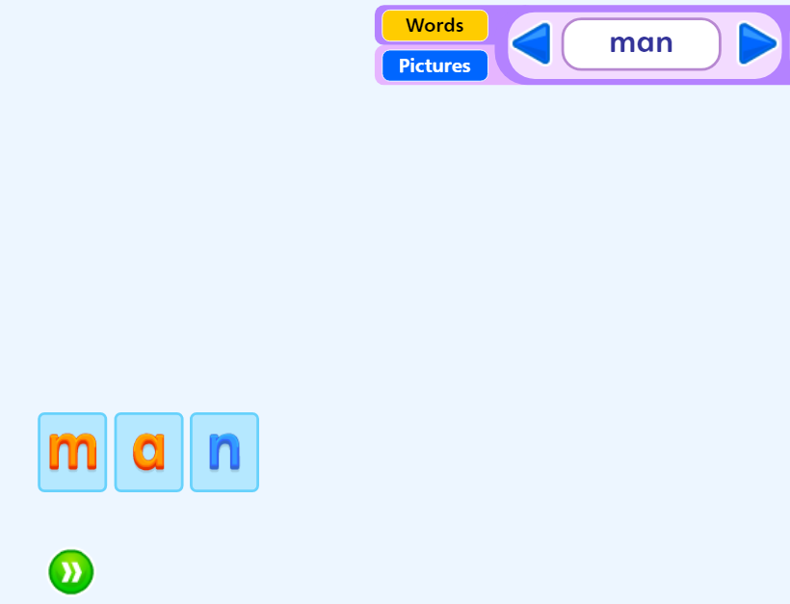
Phonics at Christ Church
Reading (decoding)
Spelling (decoding)

Slide 18
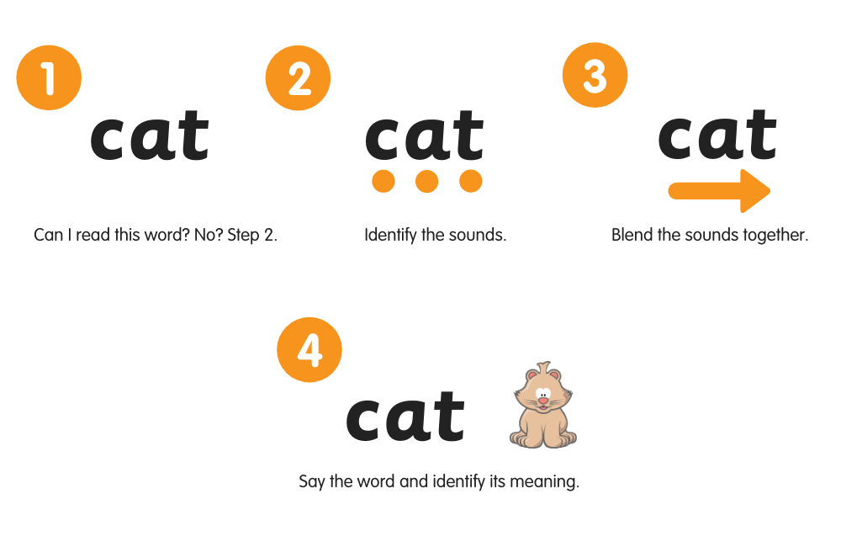
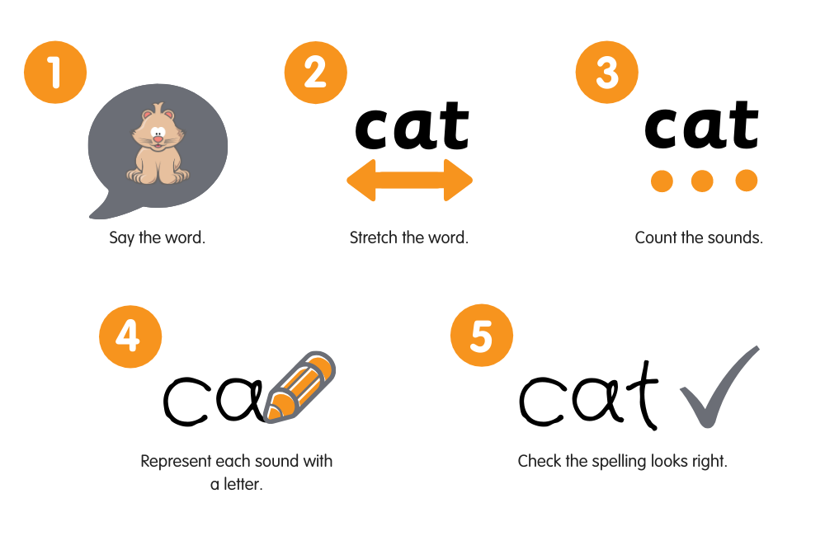
Reading
Writing

Slide 19
Reading in School
At Christ Church, children will mostly read in small groups.
A teacher will hear every child read at least once a week.
Children in Reception have the opportunity to access books and read on a daily basis.
All the children in Reception will have a Reading Record where a record of their reading is kept, along with the books they have read.
A teacher will date and sign your child’s reading record when they have read with them in school.
All the children in Reception will bring home one book per week that will match their phonic level. Some books may have no words and some will have very few words to begin with.

Slide 20
Reading in School
Your child will receive one book to take home each week.
This book will need to be brought back into school on a daily basis.
- If your child has read their book from start to finish you can:
  1. Try to read the book out of sequence (children are good at learning their books by rote!).
  2. Make up your own story using the pictures.
  3. Think of an alternative ending for the story.
  4. Do a sound hunt/tricky word hunt throughout the book.

Slide 21
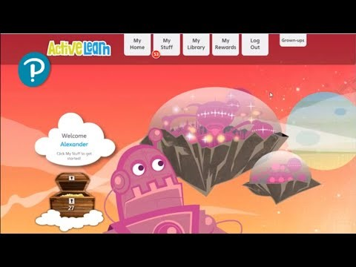
Bug Club
- Your child will receive their own log-in for Bug Club to enable you access at home.
- There are Phonics games and books linked to our learning that may be assigned to your child on Bug Club too.
Overview of Bug Club Phonics for parents and carers – YouTube

Slide 22
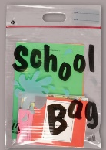
How can you support your child on their reading journey?
Read with your child daily (and sign their Reading Record)
Ensure that your child brings their reading bag, reading diary and reading book into school daily.
Watch: Phonics: How to pronounce pure sounds | Oxford Owl – YouTube to support your child’s pronunciation of sounds.
On your tables are some resources for you to take away that you may want to use with your child.

Slide 23
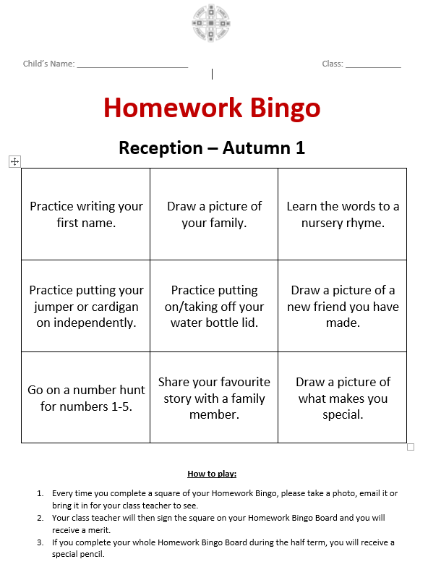
Homework Bingo
A Homework Bingo sheet will be put into the back of your child’s reading diary each half term.
After completing a task, send a copy of it into school either physically or electronically.
Please tick the task off on the sheet when you have completed it to let us know.
If your child completes all nine tasks, they will receive a certificate and pencil at the end of the half-term.

